Slide 1
Delivery guidelines
Right and wrong examples
2014

Slide 2
Contents
Usable pallet-types
Not usable pallet-types
Common information concerning pallets
Accepted pallet sizes
Pallet height
Exception of the pallet height and size
Pallet wrapping
Delivery of more than 15 cartons
Products jut out of the pallet
Condition of pallets
Marking of mixed pallets
Marking of mixed boxes
Missing EAN/VPN on the Single Unit
Missing EAN/VPN on the Case
EAN/VPN not usable
Serial-number marking of Single Units
Serial-number marking of Cases
Deficient loading quality
Examples of risks by using wrong pallets
Excerpt from the relevant delivery-guidelines

Slide 3

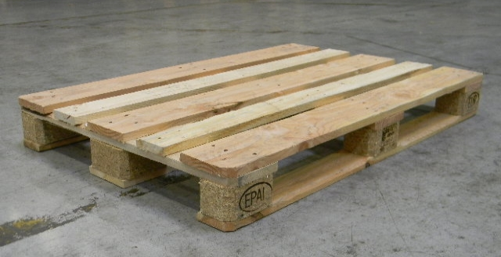
Euro-Pallet 0.80m * 1.20m

Slide 4
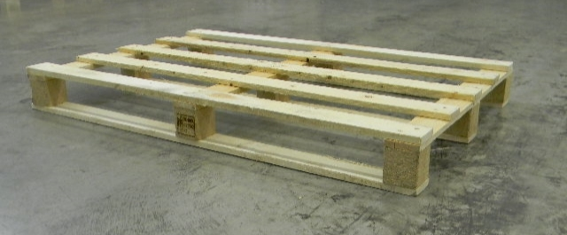
One way pallet (no returnable pallet) 0.80m * 1.20m
One way pallet with the same size and construction like an euro-pallet
Weight !!!:
Not allowed if the weight of the products is to heavy for storing them in the racks (see attached pictures)

Slide 5
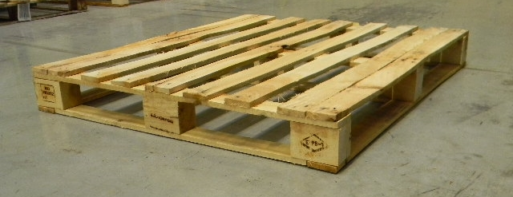
Industrial-pallet 1.00m * 1.20m
Bottom runners on the short and the long side of the pallet
=> it‘s stable

Slide 6
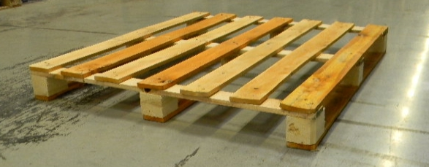
One way pallet (Industrial size) 1.00m * 1.20m
Important:
The pallet must always have a bottom runner on the long side (1.20m)
If the bottom runner is only on the short side (1.00m) it is a wrong pallet type

Slide 7
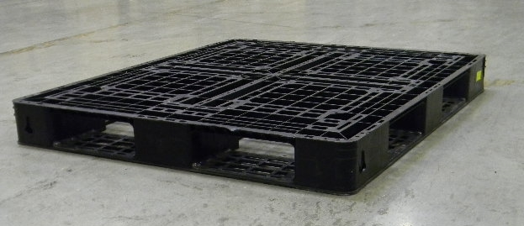
Plastic pallet (industrial size 1.00m * 1.20m)
Only this construction of a plastic pallet is allowed.
Bottom runner around the whole pallet. Bottom runner must be connected with every block => stability
(not allowed versions of plastic pallets see next slide)

Slide 8

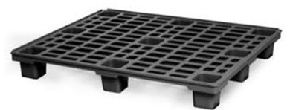
Plastic-pallet
This construction of a plastic pallet is not allowed.
Problem: stability
=> has no bottom runner

Slide 9
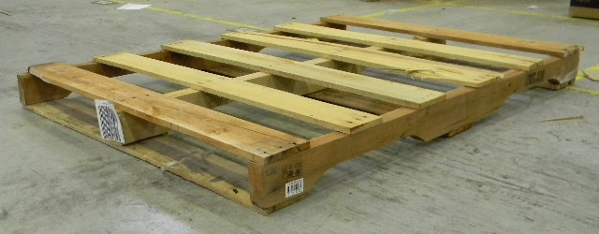
Wrong Pallet type
,,american pallet type‘‘
Although this pallet-type has the right size it‘s not usable because of the construction (not the same like an Euro-pallet)
Problems:
No bottom runner on the long side of the pallet
Too small access openings on the long side of the pallet
Pallet-type doesn‘t fit with the picking modul and pallet conveyer

Slide 10
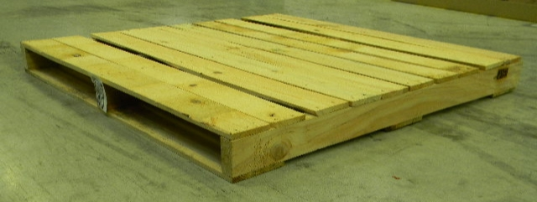
Wrong Pallet type
,,american pallet type‘‘
Although this pallet-type has the right size it‘s not usable because of the construction (not the same like an Euro-pallet)
Problems:
No bottom runner on the long side of the pallet
No access openings on the long side of the pallet
Pallet-type doesn‘t fit with the picking modul and pallet conveyer
They get damaged

Slide 11
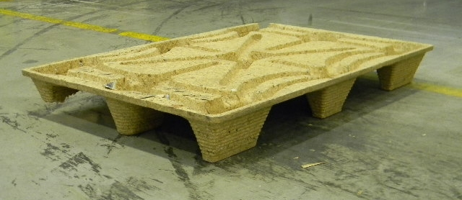
Wrong Pallet type
,,pressboard-pallet‘‘
Problems:
No bottom runners
stability
Pallet-type doesn‘t fit with the picking modul, the racks and the pallet conveyer
Wrong material

Slide 12

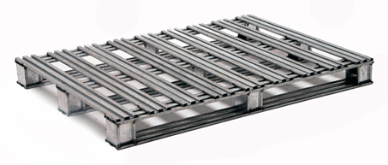
Metall-pallet
Allowed:
sizes 0.80m * 1.00m and 1.00m * 1.20m
Not allowed:
All other sizes e.g 1.00m * 1.00m

Slide 13
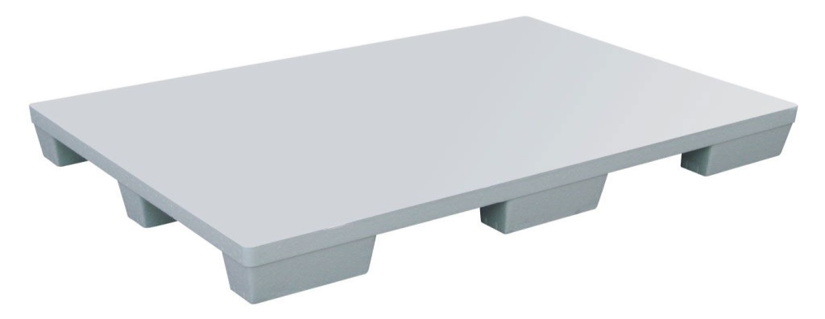
Styrofoam-pallet
Problems:
No bottom runners
stability
Pallet-type doesn‘t fit with the picking modul, the racks and the pallet conveyer
Wrong material

Slide 14
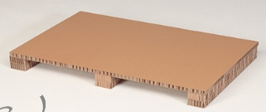
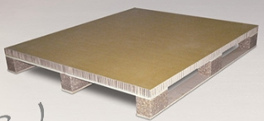
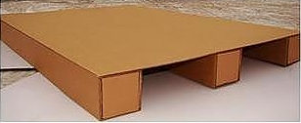
Carton-pallets
Problems:
No bottom runners
stability
Pallet-type doesn‘t fit with the picking modul, the racks and the pallet conveyer
Wrong material

Slide 15
Common information concerning pallets
Accepted:
Euro-pallet
Industrial-pallet
One-way-pallets with the same construction and sizes like Euro- and Industrial-pallets
Plastic-pallet (only one type which is in the presentation)
Metall-pallets when they have the right sizes and construction
Not accepted:
,,American-pallet-type
Plastic-pallet
Plywood-pallet
Carton-pallet
Styrofoam-Pallet
,,Pressboard-pallet‘‘
Not accepted:
All types of pallets with different sizes than 0.80m * 1.20m and 1.00m * 1.20m and with different constructions of the pallets.
Exception:
The single product itself is bigger than the dimensions of the mentioned pallets.
=> Safety of the product has priority

Slide 16
Pallet sizes
Allowed:
Sizes: 0.80m * 1.20m and 1.00m * 1.20m
Not allowed:
Every sizes different from the sizes mentioned above
Exception:
The single product itself is bigger than the dimensions of the mentioned pallets.
=> Safety of the product has priority

Slide 17

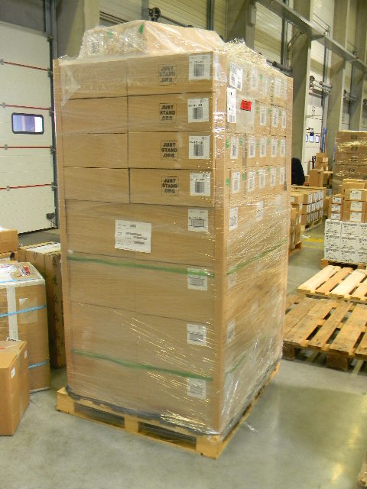
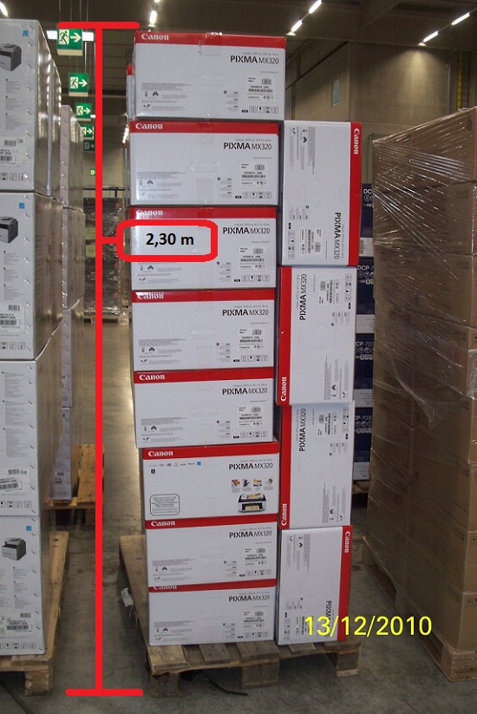
Pallet height
Maximum pallet height 2.20m (products inclusive pallet)
correct
Within the guideline
incorrect
outside the guideline

Slide 18
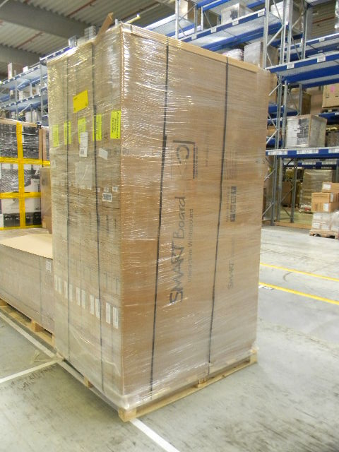
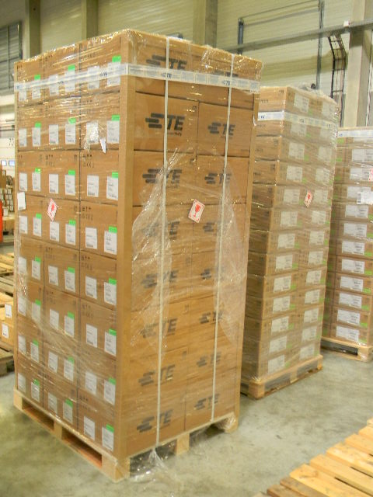
Exception
Pallet height and pallet size
1.40m
Exception:
The single product itself is bigger than the dimensions of the mentioned pallets.
=> Safety of the product has priority
0.28m
0.44m
0.60m
2.34m
2.30m
1.00m
1.40m
1.32m
1.20m
Dimensions of the single product are bigger than
1.20m (size) to 2.20m (height)
Dimensions of the single product are smaller than
1.20m (size) to 2.20m (height)

Slide 19
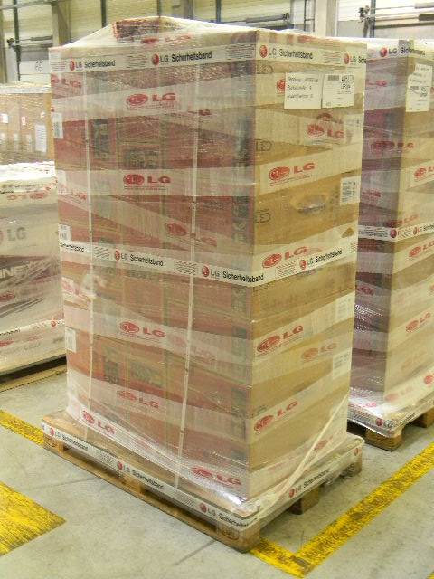
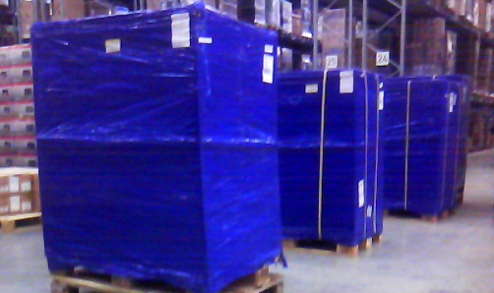
Pallet-wrapping
Only transparent pallet-wrapping is allowed
Wrapped transparent
Wrapped intransparent

Slide 20
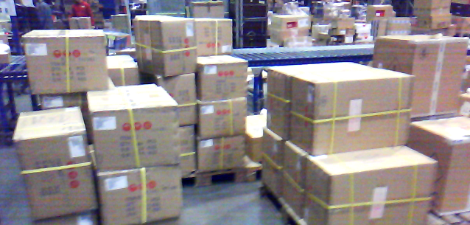
Delivery of more than 15 cartons
Palletizing:
Deliveries of more than 15 cartons have to be palletized
No loose cartons; palletized
=> correct
Loose cartons; not palletized
=> incorrect

Slide 21
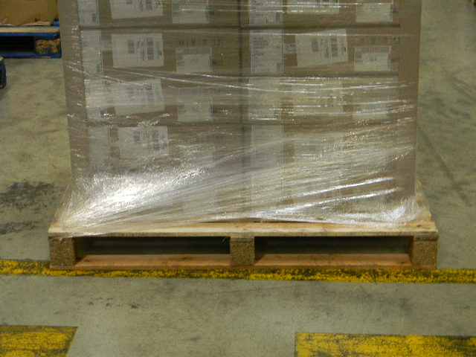
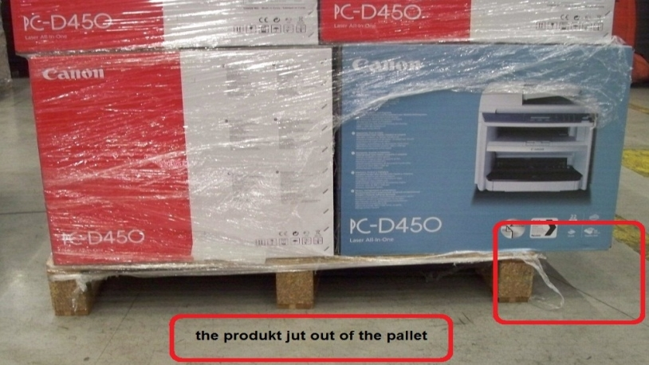
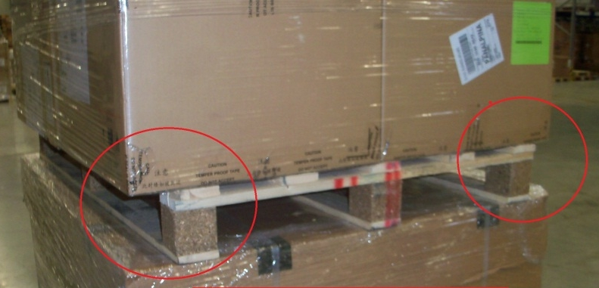
Products jut out of the pallet
Products hang over the edge of the pallet
The products may not jut out of the pallet

Slide 22
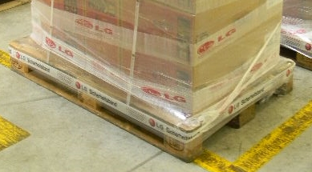
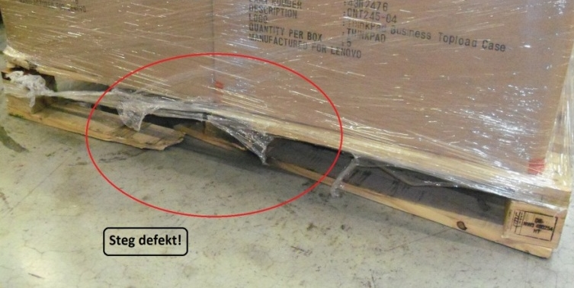
Condition of pallets
intact
damaged

Slide 23
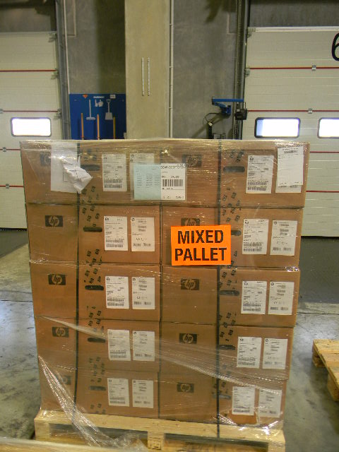
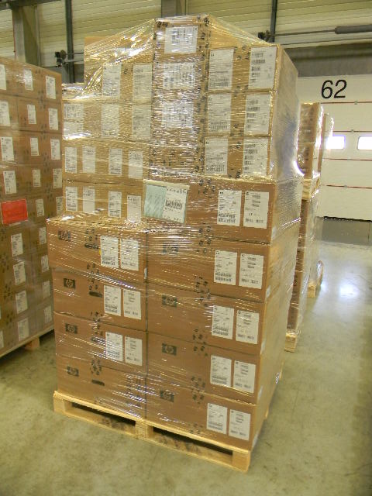
Marking of mixed pallets
A mixed pallet must be marked with an additional label to avoid mistakes
Marked
=> Correct
Not marked
=> incorrect

Slide 24
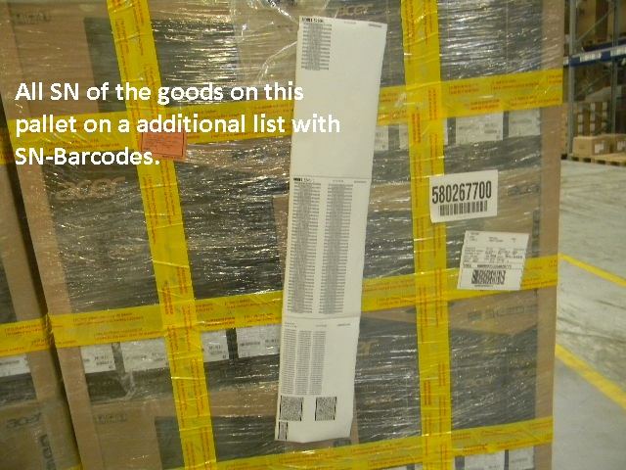
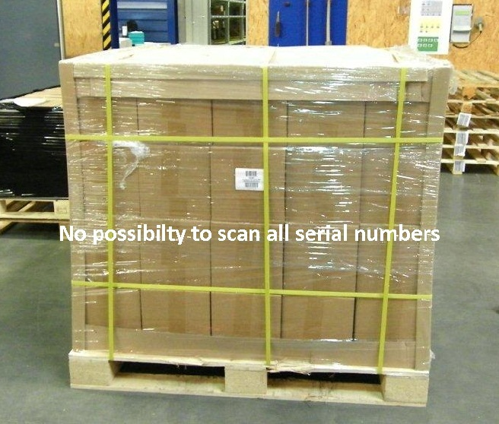
SN-Barcode Lists on full-pallets
All SNs available on pallet
No possibility to scan all SNs on full pallet

Slide 25
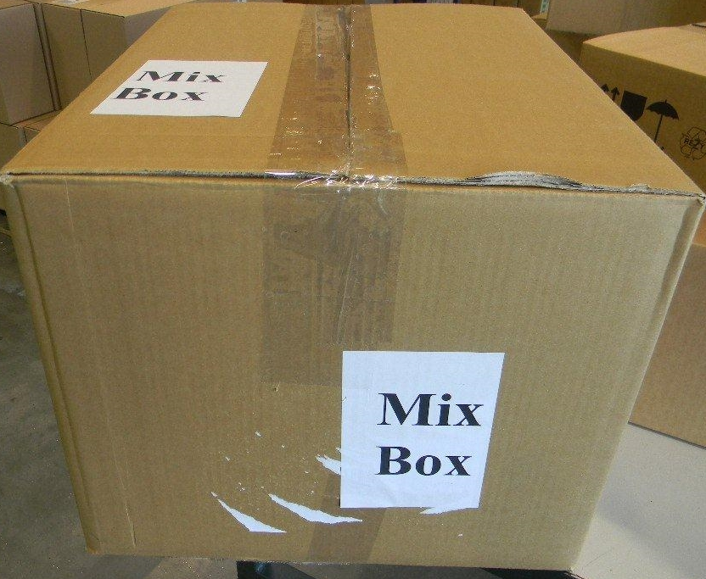
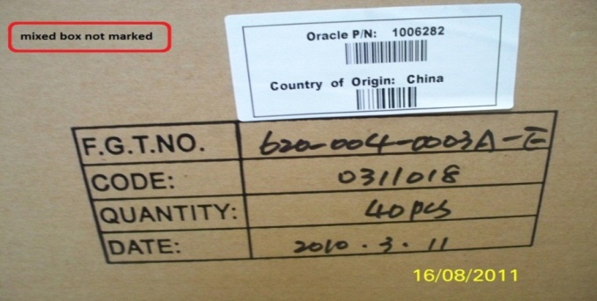
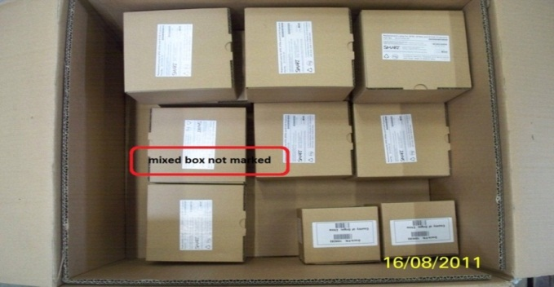
Marking of mixed boxes
Mixed cartons must be marked with an addtional label to avoid mistakes
Marked
=> Correct
Not marked
=> incorrect

Slide 26
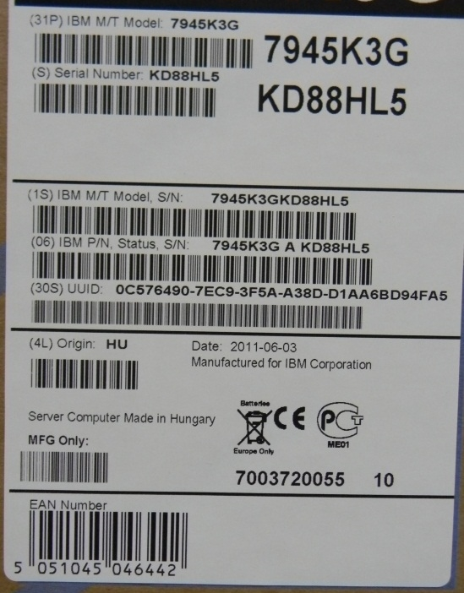
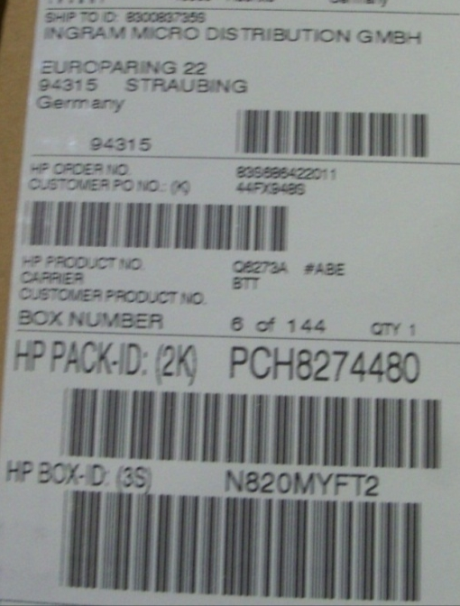
Missing EAN/VPN on the Single Unit
EAN as barcode is needed on every single unit for identification
EAN as barcode available
=> Correct
EAN not as barcode available
=> incorrect

Slide 27
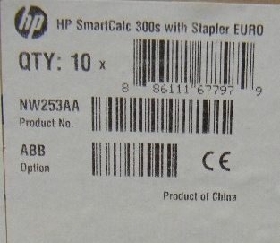
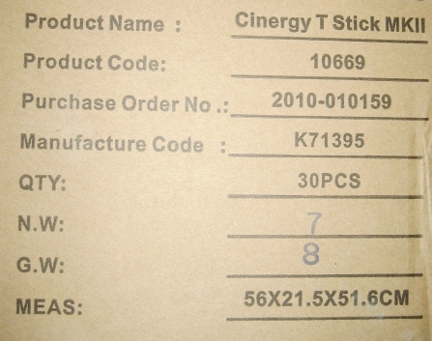
Missing EAN/VPN on the Case
EAN as barcode is needed on every Case for identification
EAN as barcode available
=> Correct
EAN not as barcode available
=> incorrect

Slide 28
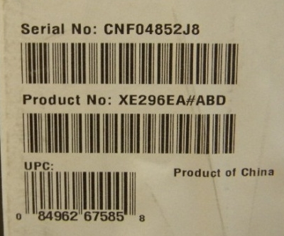
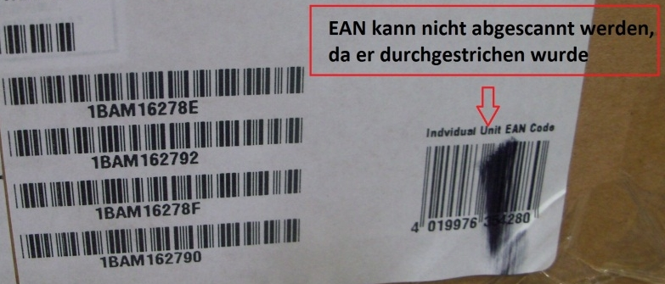
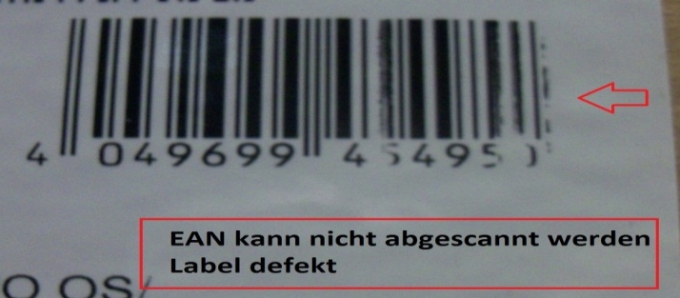
EAN/VPN not usable
The EAN/VPN must be usable (scanable)
EAN draggled
EAN defect
EAN usable
=> Correct
EAN not usable/scanable
=> Correct

Slide 29
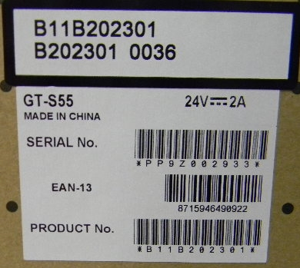
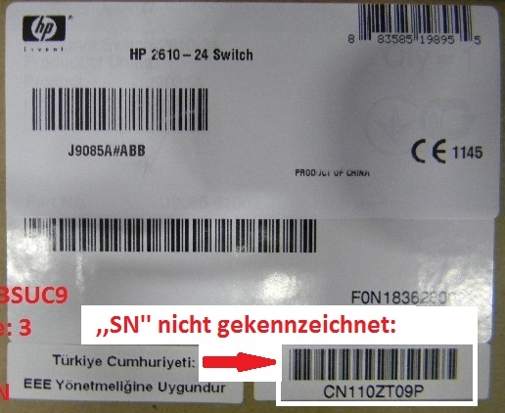
Serial-number marking of Single Units
The serial number of a Sinlge Unit must be marked
SN marking:
e.g.:
SN
Serial No.
Serial Number
etc.
SN not marked
SN marked
=> Correct
SN not marked
=> incorrect

Slide 30
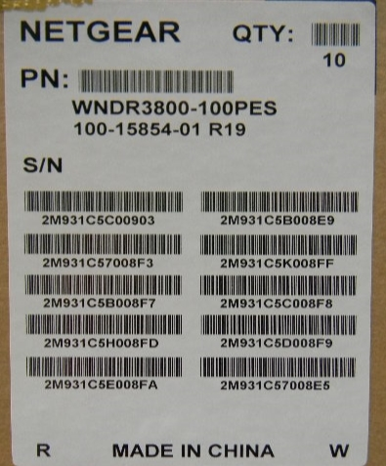
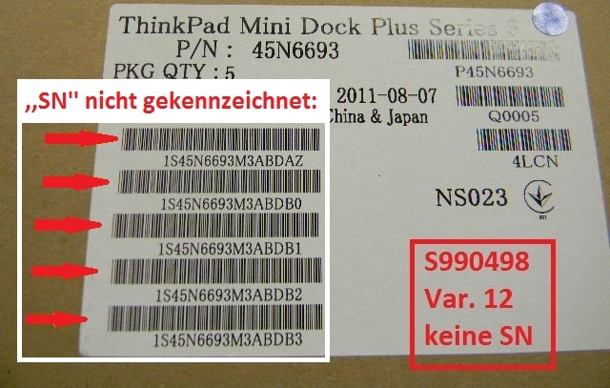
Serial-number marking of Cases
The serial numbers of Cases must be marked
SN‘s not marked
SN´s marked
=> Correct
SN not marked
=> incorrect

Slide 31
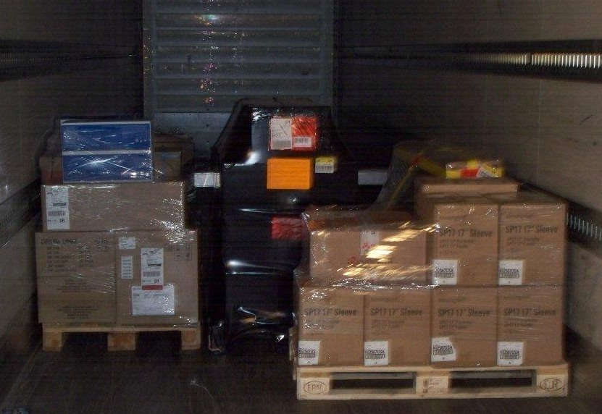
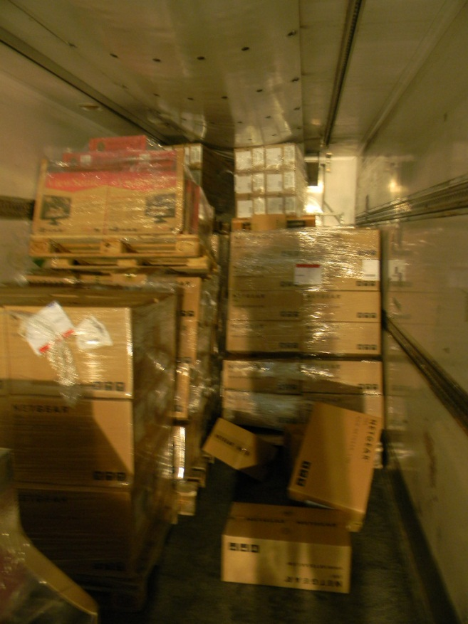
Deficient loading quality

Slide 32
Attachment
Examples of risks by using wrong pallets
Excerpts from the delivery-guidelines
2014

Slide 33
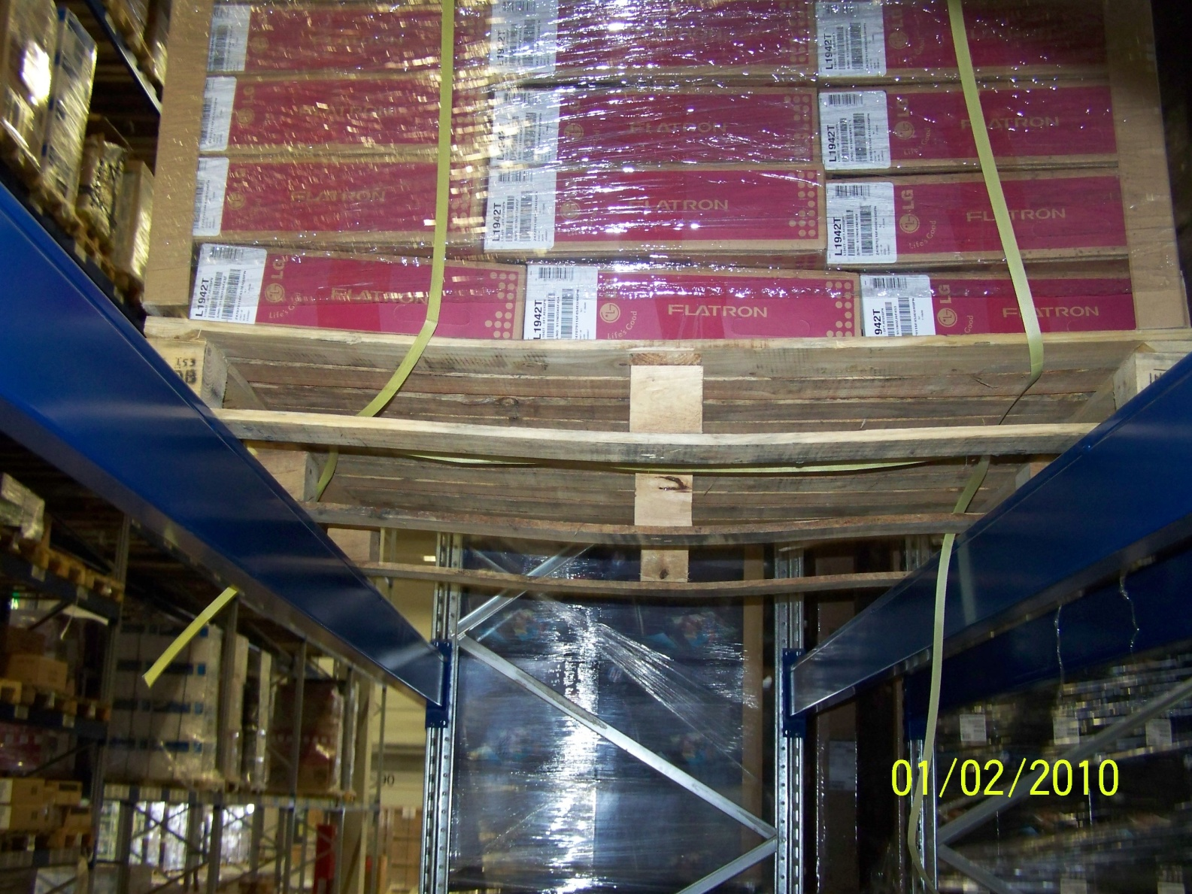
Examples of risks by using wrong pallets

Slide 34
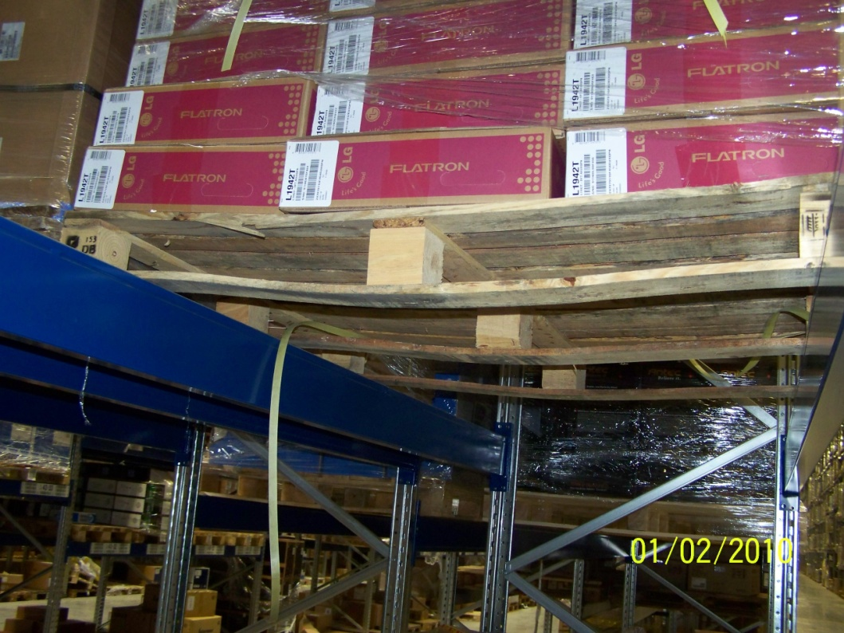
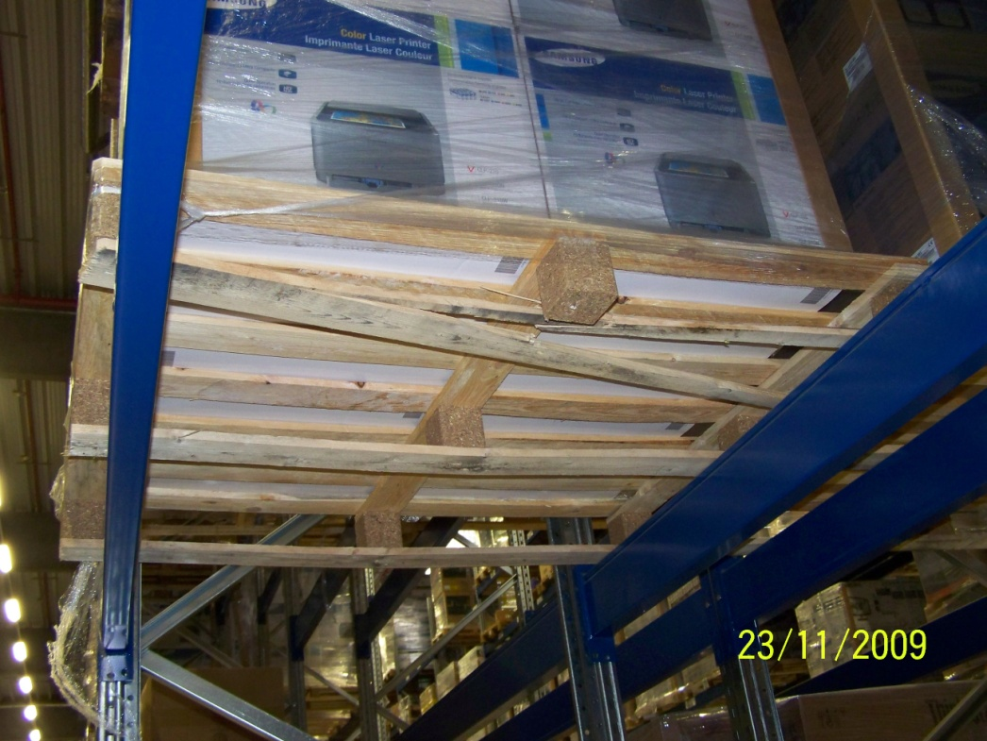
Examples of risks by using wrong pallets

Slide 35
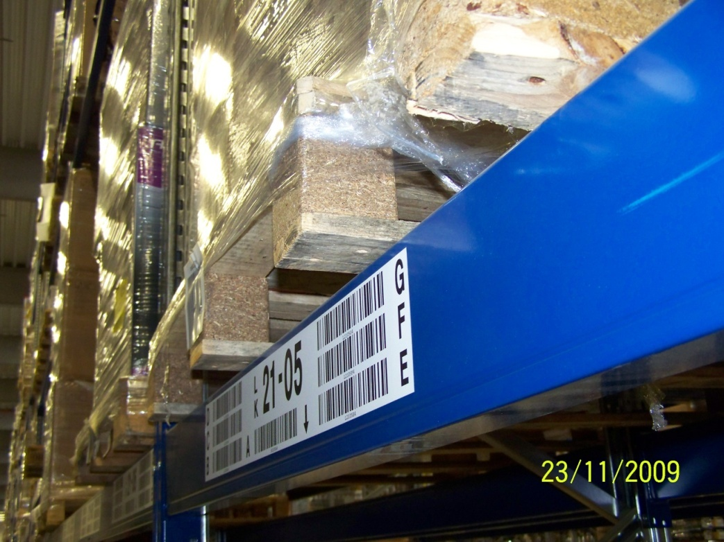

Examples of risks by using wrong pallets
Pallet is too big and the blocks are too small
Blocks are not exact on the cross-beam
The whole weight of the pallet is pressing on the boards
Consequences: deformation

Slide 36


Worst-case
This pallet is standing on the floor and has a deviation because of the poor pallet quality
Not possible to store this pallet
We have to rebuild it
Because of the weight and the poor quality of the pallet this pallet broke and fall down through the rack.
Dangerous for employers
The goods are scrap

Slide 37

Excerpts from the relevant delivery-guidelines

Slide 38

Excerpts from the relevant delivery-guidelines

Slide 39

Excerpt of the delivery-guidelines
Marking of the articles and the pallet

Slide 40

Excerpt of the delivery-guidelines
Pallet dimensions and construction

Slide 41
Delivery guidelines
Right and wrong examples
2014

Slide 42
Relevante Auszüge aus den IM-Richtlinien für Lieferanten
Anlieferrichtlinien - 7. Anforderungen an Palettenware
7.1 Palettenmaße
Generell sind für den Transport Euro-Flachpaletten (1200 x 800 mm) zu verwenden.
Sollte dies nicht möglich sein, können die Waren alternativ auf Einwegpaletten transportiert werden, sofern
die Maße der Einwegpaletten mit den Maßen von EURO- oder Industriepaletten (1200 x 1000)
übereinstimmen und die bezüglich der Einfahröffnung geltenden Anforderungen, im einzelnen in unserem
Lieferantenhandbuch in Abschnitt 5.1 genannt, erfüllt werden.
Grundmaße von Paletten sind einzuhalten, Überstände unbedingt zu vermeiden.
Die angelieferten Paletten dürfen maximal 2000 mm hoch sein (Produkt inkl. Palette).
7.2 Palettenbeschaffenheit
Grundsätzlich sind Flachpaletten aus Holz zu verwenden.
Die angelieferten Paletten müssen gebrauchsfähig sein. Beispiele für nicht gebrauchsfähige Paletten sind in
unserem Lieferantenhandbuch in Abschnitt 5.2 beschrieben.
Im Folgenden wird auf die Folgen bei Nichteinhaltung der unter Abschnitt 7.1 genannten Richtlinien
ausdrücklich hingewiesen (zur Bedeutung der verwendeten Schlüssel K1-K3 siehe Abschnitt 9):
• Paletten sind nicht gebrauchsfähig – weisen also Mängel wie in unserem Lieferantenhandbuch in Abschnitt 5.2 beschrieben auf K2 ➔ … K2 Berechnung des entstandenen Mehraufwands gemäß Preisliste
Lieferantenhandbuch – 5.2 Palettenbeschaffenheit
Flachpaletten sind nicht gebrauchsfähig, wenn sie die nachfolgend aufgezählten Schäden
bzw. Mängel aufweisen:
…
• Es sind offensichtlich unzulässige Bauteile für die Reparatur verwendet worden (zu schmale, zu kurze Bretter oder Klötze)
• Der Allgemeinzustand der Palette ist so schlecht, dass die Tragfähigkeit nicht mehr gewährleistet ist oder Ladegüter
verunreinigt oder beschädigt werden können.

Slide 43
Bestimmte Aussagen dieser Präsentation könnten als zukunftsbezogen im Sinne des United States Private Securities Litigation Reform Act von 1995 gelten. Diese Aussagen umfassen eine Reihe von Faktoren, die bewirken könnten, dass tatsächliche Unternehmensergebnisse wesentlich abweichen. Zusätzliche Informationen diese Faktoren betreffend sind im „Form 10-K“ 2012 Geschäftsbericht unter „Item 1A“ sowie in zukünftigen bei der SEC eingereichten Dokumenten zu finden. Kopien sind erhältlich bei der SEC, über die Firmenwebsite und über Ingram Micro Investor Relations.

